Slide 1

The Nature of knowledge
Learning objectives:
Consider where knowledge comes form
Identify different types of knowledge
Know difference between 2 approaches
Practice applying the process

Slide 2

Where does knowledge come from?
Assimilation of information
Tradition
Common sense
Trial and error
Intuition
Scientific knowledge

Slide 3
Knowledge is often divided into 4 areas- technical rationality, personal, experiential, ethical, moral (Sussex et al 2008)
 | Technical rationality | Personal/practical | Experiential | Ethical/ moral
Context of care | Facts about Gvt policy | Policies, funding and organisations change over time | Knowledge of how to ensure organisations respond to new legislation | Valuing your role in promoting the values of the organisation
Assessment | What assessment tools to use | First impressions at contact with people | That service uses have different expectations | Importance of person choice,
Adult protection | Legislation – knowing what yr responsibility is for protecting vulnerable adults | Awareness of abuse as an issue in society | Knowledge of difficulties in maintaining confidentiality | Valuing people as having right to be free of abuse

Slide 4
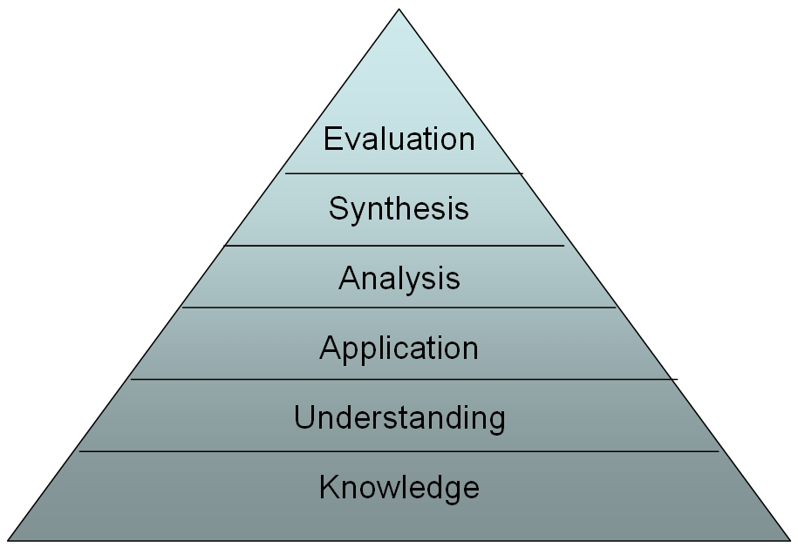
What can we do with knowledge
Evaluation: Looking back at a situation using knowledge to make sense of it
Synthesis: Bringing together different areas of knowledge to understand a situation or skill
Analysis: Thinking about knowledge from different angles, asking yourself questions about it
Application: Using the knowledge by connecting it to the work situation
Understanding: making sense of the knowledge
Knowledge: Information, facts

Slide 5
Fact or opinion?
Susan manages a supported living scheme. She is reflecting on how effective her care practice is.
“I know what people think of the scheme because the tenants complete questionaires. The tenants know they can complain about anything that they are not happy with. Staff inform me of any issues in supervision, and the tenants have regular meetings at which they can say anything”
What is fact and what is opinion?

Slide 6
Reflection
Sometimes our impression of what’s happening is influenced by our expectations of what should be happening/
It is important to know how to interpret information and how to make sense of individual pieces of information

Slide 7

Why research? The need to find the truth value
And if the blind lead the blind, both shall fall into the ditch (Mathew 15:14)

Slide 8
What is Research?
“A form of systematic enquiry that contributes to knowledge”
Systematic
Rigorous
How we examine our professional activity
Notes:
Definition - www.resmind.swap.ac.uk

Slide 9

Greatest Medical Discoveries
Anaesthesia
Antibiotics
Chlorpromazine (Largactyl)
Discovery of DNA structure
Computers
Evidenced based medicine
Germ theory
Imaging techniques
Immunology
Oral rehydration therapy
The pill
Risk of smoking
Sanitation
Tissue culture
Vaccines
Genetic engineering
Notes:
BMJ conducted a survey to determine greatest medical discoveries
Scientific progress in last 150 years, collectively these have saved billions of lives. Without research medicine would be impotent
Largactyl – anti psychotic

Slide 10
Objective of research
Gain a more comprehensive knowledge or understanding of the subject under study
Systematic intensive study, primary aim to gain fuller knowledge or understanding
Inquiry directed toward a phenomena or observable facts

Slide 11
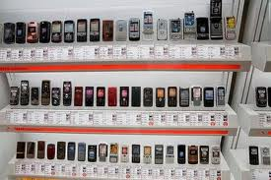
Activity 1
Conduct your own research!
You want to buy a new mobile phone.
In your group, decide what data you will collect which will help you to decide which phone to buy.

Slide 12
Quantitative Research
  Measures and analyses in a numerical way…
  Answers the ‘how many’ ‘A versus B’ survey type where there are a limited number of responses. Structured questionnaires, measuring scales and physiological measurement
Qualitative Research
  Asks the why! Gathers non numerical data such as words and text – Interviews and observations

Slide 13
Qualitative methodology
Social research which is carried out in the field (natural settings) and analysed largely in non-statistical ways…Bowling (1997)
Health and Social care reasearch is congruent with qualitative approaches…with its focus on the experiences of people….stresses the uniqueness of individuals….Parahoo (1997)

Slide 14
Quantitative methodology
To do with gaining new knowledge
Deals with ‘hard’ data, numbers , statistics, structured data and large samples

Slide 15
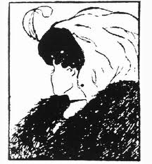

Slide 16
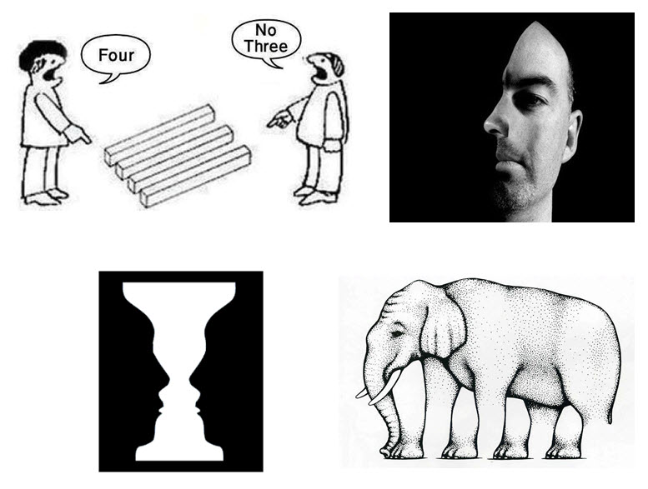

Slide 17
Research methodology
What are the main approaches to research?
What are the differences?
Notes:
So recap - quant

Slide 18
Introduction to quantitative and qualitative research
Quantitative
deductive
Statistical (numbers)
Causes
Explain
Theory testing
Experimental
Control/rigour/replication
Objective (etic)
Problem known to researcher
Qualitative
Inductive
Understand (words)
Interpret
Find reasons
Experiences of people
Exploratory
Variable not controlled
Subjective (emic)
Little known about phenomenon

Slide 19
Quantitative and Qualitative data
Description | Quantitative Data | Qualitative Data
Purpose | More useful for testing Provides summary information on many characteristics Useful in tracking trends | More useful for discovering Provides in depth (deeper understanding)information on few characteristics Discovers hidden motivations and values
Properties | More structured collection techniques and objective ratings High concern for representativeness Relatively short interviews (1 -20 minutes) Interviewer is passive Large samples (over 50) Results objective | More unstructured collection techniques requiring a subjective interpretation Little concern for representativeness Relatively long interviews (1/2 to many hours) Interviewer is active and should be highly skilled Small samples (1-50) Results subjective

Slide 20
For next week – in pairs, find out about one of the following to present to class
Everyone – revise quantitative and qualitative approaches
Systematic Review
Randomised control trials
Cohort studies
Case Control Studies
Modelling Studies
Longitudinal studies
Grey literature

Slide 21


Slide 22
Table 1
What research can do
Purpose | `Types of research study' | Example
Describe the current situation | Descriptive studies (surveys of people or practice) | How many young people start to smoke while at school
Look for an explanation for current behaviour | Qualitative research (Interviews/surveys) | Why many elderly people are reluctant to seek help
Test a hypothesis based on a prediction | Quantitative research (Clinical trials and laboratory-based studies) | That massage is more effective than single-remedy treatments for back pain.
Seek generalisations | Multi-centre trials and systematic reviews of controlled trials | Is nicotine replacement therapy better than willpower alone to stop smoking
Source: RCCM [Online]

Slide 23
Perhaps you came up with some of the following…
What do you need to know? (The research question)
What information do you need? Literature review)
Who will you ask (target population)
How will you collect the information (data collection)
How will you present the results (data analysis)

Slide 24
Stages of the research process
Identify the problem, question(s) to be answered
Plan the approach (quantitative / qualitative / both)
Search the literature, sources of data
Critical read the literature
Set research question/s to be answered, aims & objectives of research
Ethical considerations
Timeline
Method of data collection
Method of data analysis
Interpretation & conclusions
Notes:
Usually research design includes the following
Identification of researcher’s own beliefs -refexivity

Slide 25
What is data collection
The gathering of information needed to address the research aim/hypothesis/problem….Polit and Hungler (1999)
When selecting a method of data collection the researcher must be confident that the tool chosen will collect information relevant to the research question and support the approach taken…Hek (1997)

Slide 26
Types of data collection
Types of data collection
 | Quantitative | Qualitative
Interviews face to face; structured, semi- structured; | X | X
Questionairres | X
Observational study | X
Focus groups |  | X
Surveys | X

Slide 27
Sampling
Identify the target population from which information can be collected. Obtain a sample which represents the target group.
Large numbers
  Random
  Systematic random sampling
  Stratified
  Non-random (normally qualitative)
    Convenience
    Purposive

Slide 28
Data analysis
Descriptive Statistics
  Graphs
  Pie charts
  Percentages
  Averages (mean, mode, median)
  Cross correlations, differences or similarities between different groups

Slide 29
What approach?
Exploration of elderly people perceptions of a befriending service?
Factors which influence teenage girls smoking
Is exercise more effective than diet for weight loss in obese adults?

